Slide 1
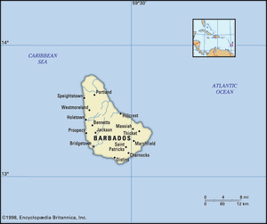
Barbados
© 2024 D. McDaniel SUCOL - ICLP

Slide 2
Overview
Barbados is an island country in the southeastern Caribbean Sea, situated about 100 miles east of Saint Vincent and the Grenadines. The capital and largest town is Bridgetown, which is also the main seaport.
As of 2024 the population is estimated to be 263,700. People of African descent and mixed African-European descent make up more than nine-tenths of the population. English is the official language, and a nonstandard English called Bajan is also spoken.
There are approximately 972 lawyers in Barbados. These lawyers specialise in areas of law such as ADR, Administrative Law, Banking Law, CARICOM Law, International Tax Law and Wills.
https://barbadosbarassociation.com/members_directory.cfm

Slide 3
Education
Primary education begins at age 4 and continues until age 11, when students sit the Barbados Secondary School Entrance Examination (BSSEE) and transition to secondary school. There are no school fees at public primary schools.
Secondary education is provided for children ages 11 to 18 years. At age 16, students write the Caribbean Examination Council (CXC) examinations Caribbean Secondary Entrance Certificate (CSEC) - the equivalent of GCE O-Levels. At about age 18, those students who continue at school can sit the CXC- Caribbean Advanced Proficiency Certificate (A-Level).
The government prioritizes education by allocating a significant portion of its budget to it. All education in public institutions is free.
Most studies at the university level are done at the University of the West Indies, which maintains a Barbados campus at Cave Hill, near Bridgetown.
Notes:
Primary, Secondary, Territory, Law school

Slide 4
Legal Education in Barbados
Students who wish to practice law in Barbados must first complete a first-year degree (Bachelor's Degree) in law from a university. Having completed their Bachelor of Law (LLB) at the University of West Indies they must complete further training to receive the Certificate of Legal Education from a law school in one of the nearby islands (Trinidad & Tobago, Jamaica, or the Bahamas).
The Barbados Law Degree
Barbados only has one university; the University of the West Indies Cavehill, and its Law Programme was established in 1970. It provides the training necessary before pursuing professional legal training in the Commonwealth Caribbean. The programme is divided into three parts, and the resulting degree is the LLB (Bachelor of Law) degree. Each of the three parts must be completed before a student can move on to the next one.
In addition to the Bachelor of Law degree (LLB), Barbados law students can pursue a Master of Laws (LLM) or Postgraduate Diploma in Corporate and Commercial Law, Public Law, or Legislative Drafting.
Earning a Law Degree in Barbados
The chance to study in the Caribbean while earning a law degree in British common law is appealing to many students. While the program is selective, those who are admissible will find that the academic offerings are rigorous and challenging.
The academic year in Barbados begins in the fall in late August, and that semester runs through the end of December. This is followed by a second semester beginning in January and running through May. An optional summer semester that spans May, June, and July is also available. Full-time students must attend the spring and fall semesters and must take at least five three-credit courses.
Upon graduation with a law degree in Barbados, successful students will have the opportunity to pursue further legal training in the Caribbean. Some will be equipped to begin a legal career in one of the many countries that practice common law. For many, a Barbados law degree is a starting point for further legal training.

Slide 5
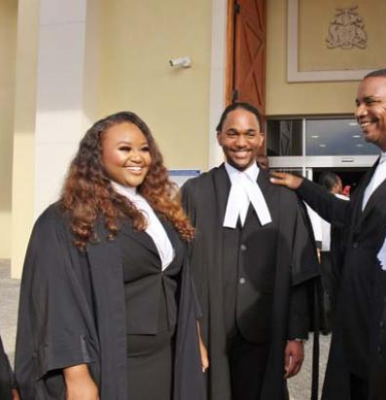
Admission to Practice Law Cap. 370A Legal Profession (barbadoslawcourts.gov.bb)
“1) A person who after 31st December 2004 applies to the High Court to be admitted to practise
law and who satisfies the Court that
(a) he is
(i) a citizen of Barbados; or
(ii) a citizen of a country specified in the First Schedule* in which there is a law in force conferring the status of citizenship of that country; or
(iii) regarded as belonging to a country specified in the First Schedule under any law in force in that country; or
(iv) a national of another Member State;
(b) he has attained the age of 21 years;
(c) he has obtained the prescribed qualifications; and
(d) he is of good character, shall, upon compliance with the requirements of this Act and, unless that person is exempt therefrom, on payment to the Registrar of the first registration fee for registration, be entitled to be admitted by order of the court to practise law.
(2) An appeal lies to the Court of Appeal from an order of the High Court refusing an application made under this section.
(3) Rules of court may prescribe the practice and procedure to be followed in relation to applications and appeals under this section.”

Slide 6
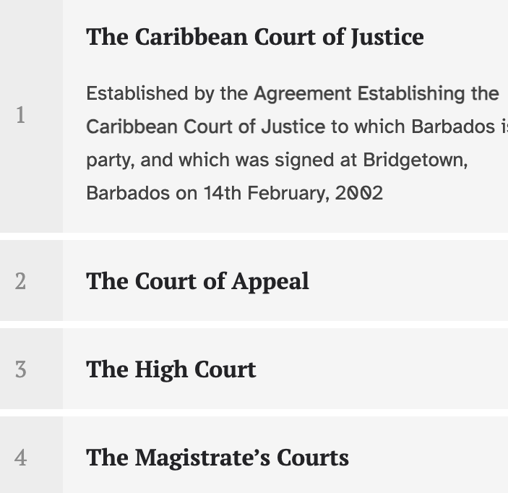
Justice/Court System
The Judicature is established by s. 79C of the Constitution of Barbados. It is comprised of a three-level domestic court structure consisting of:
The Court of Appeal
The High Court
The Magistrate’s Courts
The Court of Appeal and the High Court are collectively referred to as “the Supreme Court”
The Supreme Court of Judicature consists of the High Court and the Court of Appeal.
Sections 79C and D of the Constitution place the Caribbean Court of Justice at the pinnacle of the Barbados Judicial System. The Court has two jurisdictions: appellate jurisdiction and original jurisdiction.In its appellate jurisdiction, the Court serves as the final court of appeal from any decision given by the Barbados Court of Appeal in civil and criminal matters. In its original jurisdiction, the Caribbean Court of Justice is a court of first instance that applies rules of international law in respect to the interpretation and application of the Revised Treaty of Chaguaramas. In its original jurisdiction, it exercises both exclusive and compulsory jurisdiction in:
disputes between Contracting Parties to the Agreement Establishing the Caribbean Court of Justice;
disputes between any Contracting Party to the Agreement and the Caribbean Community;
referrals from national courts or tribunals of Contracting Parties to the Agreement
applications by persons in accordance with the Caribbean Court of Justice Act concerning the interpretation and application of the Treaty.
The Court also has exclusive jurisdiction: (i) to deliver advisory opinions concerning the application of the Treaty upon request of Contracting Parties or the Community; and (ii) where there is a dispute as to whether the Court has jurisdiction in a matter, to decide whether the Court has such jurisdiction.

Slide 7
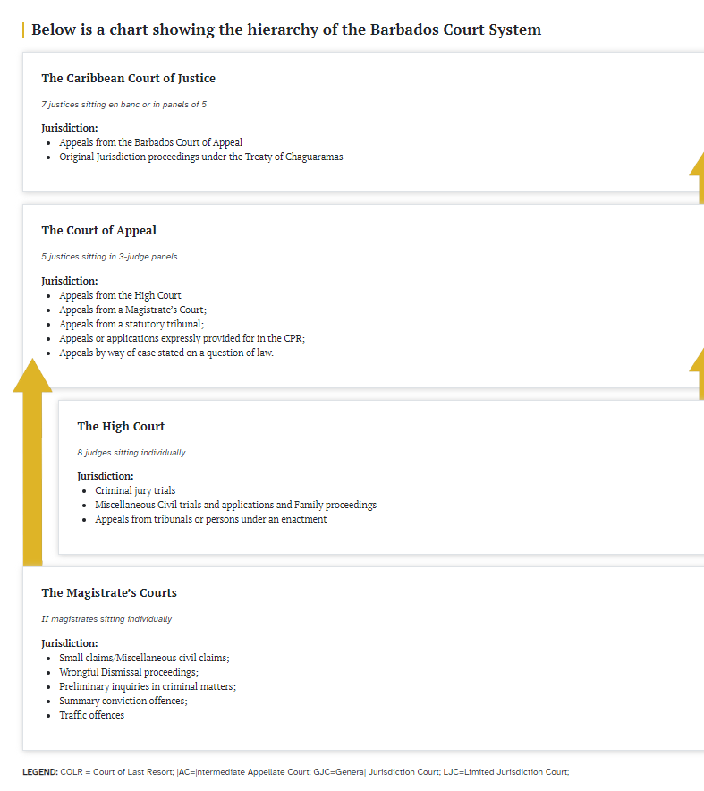
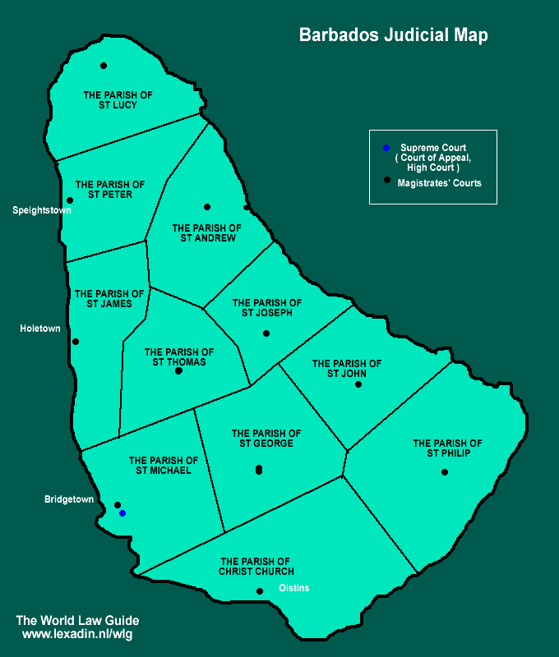
Judicial Process

Slide 8
ADR
In 2019, Chief Justice Sir Marston Gibson announced that ADR is available to judges and lawyers as a remedy in criminal cases and lawsuits. This change was included in two new practice directions, which are supplemental protocols to the rules that govern civil and criminal matters in the Magistrate's Court and the Supreme Court.
ADR can help courts achieve several goals, including:
Improving the pace of litigation by promoting the early and fair resolution of disputes
Providing litigants with outcomes that meet their needs
Enhancing litigants' satisfaction with dispute resolution in the justice system
Improving access to justice
Reducing the cost of litigation to the parties and to the court system
ADR is also part of the curriculum at the University of the West Indies' Faculty of Law, where it's a popular final year elective in the LL.B program. This could lead to more legal practitioners being enthusiastic about embracing ADR as part of the judicial system in the future.
Barbados has several ADR institutions including:
Alternative Dispute Resolution (ADR) Center of the Caribbean (AMCC)
A not-for-profit organization that offers ADR services to commercial clients from Barbados, the Caribbean, and around the world. The AMCC was established in 2017 and is based in Barbados, a neutral third-country forum that is a signatory to the 1958 New York Convention. The AMCC's services include arbitration and mediation.
Alternative Dispute Resolution Unit (ADRU)
A unit at the University of the West Indies Cave Hill Campus that aims to resolve disputes quickly and efficiently. The ADRU works with regional governments, the private sector, and stakeholders, including the AMCC. The ADRU's goals also include research for policy initiatives and training professionals.
Notes:
What, Agreements, Why ADR

Slide 9
Legal Aid
Legal Aid by the Office of the Attorney General & Legal Affairs https://oag.gov.bb/About/
Who can enquire/apply for Legal Aid?
A person charged with an offence may apply to the judge or magistrate before whom he/she appears.
A person convicted of an offence may apply to a judge before the appeal is heard.
To get legal aid, applicants must bring:
National identification card
Evidence of earnings
Evidence of expenditure
Completed application form
Legal Aid is available for:
Most serious crimes
Matters involving minors and juvenile offenders
Family matters, except divorce
Matters involving small holdings and tenantries
Constitutional matters
Any citizen, permanent resident of, or immigrant to Barbados may apply for legal aid.
Legal fees and most disbursements are covered by the Commission. If an applicant is required to make a contribution to his/her legal costs, the amount will be determined by and must be paid to the Commission.
The Commission maintains a list of attorneys-at-law who provide services to legal aid clients. Applicants for legal aid may choose a representative from that list. The assignment of the selected attorney will be subject to availability and approval by the Director.
Notes:
What, who is eligible, Cost, Process, when it is denied

Slide 10
Legal Aid
Legal Aid by the Public Affairs Office through Community Legal Services ( https://www.youtube.com/watch?v=q7SbqpmY2aI )
Available to those who are unable to privately retain an attorney or afford an attorney on their own.
Persons are entitled to apply for Legal Aid Certificates if they are charged with:
Capital Offences
Manslaughter
Infanticide
Concealment of Birth
Rape
Offence where a minor is charged
Tenants & Tenantries under;
Tenantry Freehold Purchase Act
Tenantries Control Act
Security of Tender of Small Holdings Act
Courts can also recommend cases and will do so where it is indictable and it is believed it is too difficult for a person to represent themselves, or if the matter involves a point of law that is of public interest, and they believe the assistance of an attorney is needed.
Persons can also apply for legal aid for:
Civil Matters
All Family Matters (except Divorces)
All Civil Matters involving minors
All matters under section 24 (Constitutional Redress)
Writ of Habeas Corpus
To access Legal Aid Services persons can call (246) 535-9900 and make an appointment or walk in if the matter is urgent at the Henry Forde & David Simmons Legal and Judicial Complex.

Slide 11
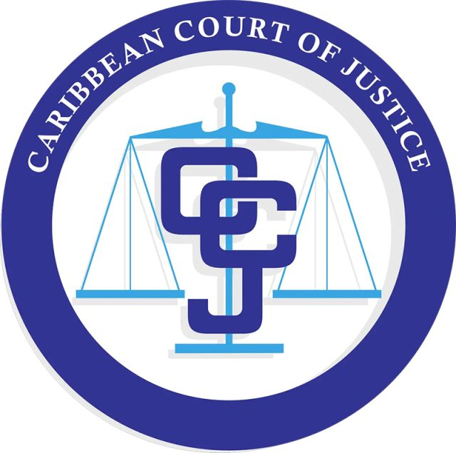
Legal News
The Caribbean Court of Justice (CCJ) has heard several cases from Barbados;
Jabari Sensimania Nervais v The Queen and Dwayne Omar Severin v The Queen (https://caricom.org/ccj-strikes-down-mandatory-death-penalty-in-barbados/ )
In 2018, the CCJ ruled that Barbados' mandatory death penalty for murder was unconstitutional in these two consolidated cases. The court found that section 2 of the Offences Against the Person Act was unconstitutional.
Roxann Rachel Goddard
(https://icaad.ngo/2023/08/21/caribbean-court-of-justice-ruling/#:~:text=Earlier%20this%20year%2C%20claimant%20Roxann,find%20Roxann%20eligible%20for%20protection )
In 2023, Goddard brought a case to the CCJ after being denied a protection order against her ex-partner. The Barbadian court had dismissed her application because she was no longer in a relationship with her partner at the time of filing. In a landmark ruling, the Caribbean Court of Justice overturned the Court’s decision, asserting that former spouses and partners have a right to seek protection orders and that there is no time limit for seeking protection after a relationship ends.
Apsara Restaurants (Barbados) Limited v Guardian General Insurance Limited
(https://ccj.org/ccj-upholds-insurers-decision-to-avoid-policy-of-insurance/ )
In 2024, the CCJ dismissed an appeal in this case and upheld decisions made by the High Court and the Court of Appeal.
The Barbados Defence Force v David Anthony Harewood
(https://barbadostoday.bb/2023/06/28/vindicated/ )
In 2024, the CCJ dismissed an appeal in this case and provided reasons for its decision in July 2024.

