Slide 1
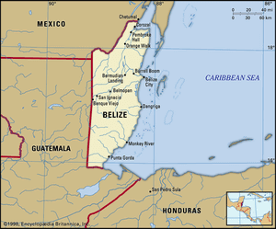
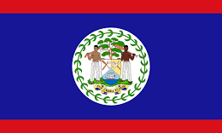
Belize
© 2024 D. McDaniel SUCOL - ICLP

Slide 2
Overview
Belize is a country located on the northeast coast of Central America. Belize, which was known as British Honduras until 1973, was the last British colony on the Americas’ mainland. Belize achieved independence on September 21, 1981, but has retained its historical link with the United Kingdom through membership in the Commonwealth. The capital is Belmopan.
The population as of 2024 is 465,000. Many Belizeans are of mixed ancestry. The largest ethnic group is those of mixed Mayan and Spanish heritage (mestizos), who account for one-half of the population. English is the official language of Belize, but most of the population also speaks a creole patois, and many Belizeans are multilingual.
There are 251 practicing lawyers in Belize.

Slide 3
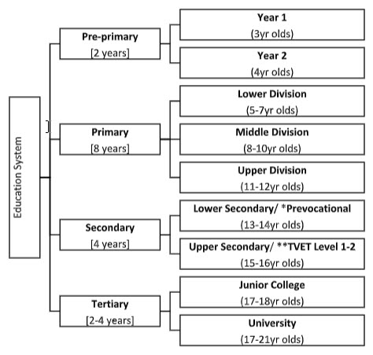
Education
Three types of educational institutions operate in Belize—government, government-aided and private. Government schools are owned and funded by the Government of Belize. Government-aided schools are schools owned by either a religious denomination or community group that receive funding from the government through school services grants or direct payment of teachers’ salaries. Private schools are owned and funded by individual persons, denominations, or private groups.
The formal education system in Belize consists of four Levels: Pre-Primary, Primary, Secondary and Tertiary. There are two years of pre-primary education, eight years of primary education and four years of secondary education. After graduating from high school, students can continue their education at the Associate or Bachelor’s degree level at a university or they can complete an Associate degree at a junior college and transfer the credits into a Bachelor’s degree program at a university.
Primary school is 8 years beginning at age 6. At the end of the 8 years, students sit for the Belize Junior Achievement Test (BJAT). Secondary school is 4 years and students are awarded a high school diploma upon successful completion. Students also sit for the Caribbean Examinations Council (CXC) Secondary Education Certificate.
Post-secondary programs are available in junior colleges and 2 universities. Junior colleges frequently offer secondary school programs as well as post-secondary programs. They also offer the 2-year Sixth Form which leads to the Caribbean Advanced Proficiency Examination (CAPE) or the General Certificate of Education Advanced Level (GCE A-Levels). The CAPE was first offered in Belize in 2004.
Admission to post-secondary programs generally requires a high school diploma. Some institutions also require passes on the Caribbean Examinations Council (CXC) Secondary Education Certificate as well as sufficient scores on the Association of Tertiary Level Institutions in Belize (ATLIB) examination. The University of Belize was founded in 2000 with the merger of University College of Belize, Belmopan Junior College, Belize School of Nursing, Belize School of Education, and Belize College of Agriculture. Galen University offers degree in cooperation with the University of Indianapolis.
Associates degree programs at junior colleges and the University of Belize are 2 years long. The Associate of Science program at the University of Belize is 3 years. Bachelors degrees are 4 years. The University of the West Indies offers some extension programs in Belize.
Notes:
Primary, Secondary, Territory, Law school

Slide 4
Law School in Belize
While The University of Belize offers a Bachelor in Criminal Justice and Criminology it has no LLB program. The LLB Program is only offered at UWI Mona, UWI Cave Hill, and UWI St. Augustine. After completing their LLB students interested in studying law must attend a Certificate of Legal Education (CLE) Law school such as the Norman Manley School of Law in Jamaica or the Hugh Wooding Law School in Trinidad and Tobago.
U.S. - educated attorneys must complete a one-year post-J.D. program CLE at one of these schools before they can be admitted to the Belize Bar.
(https://belize.com/practicing-law-in-belize/)
The Belize Bar Association was established 43 years ago and has 153 members.

Slide 5
Admission to Practice Law
“6.-(1) A person who after the commencement of this Act applies to the Supreme Court to be admitted to practice law, and who satisfies the Supreme Court that he –
( a ) is a Belizean citizen and holds a Legal Education Certificate; or
( b ) has obtained adequate training in the law and is suitably qualified and competent to practice law in Belize; or
( c ) possesses suitable practical experience and competence and is qualified to practise law in any country which the Chief Justice, after consultation with the Council, designates by Order published in the Gazette as having a sufficiently analogous system of laws, and is of good character, shall upon compliance with the requirements of this Act, and unless that person is exempt therefrom, on payment to the Registrar of the appropriate fee for registration and upon payment to the Bar Association of the annual subscription in respect of membership of that Association, be admitted to practise law and be entered on the Roll by order of the court.”
(https://belize.com/practicing-law-in-belize/)

Slide 6
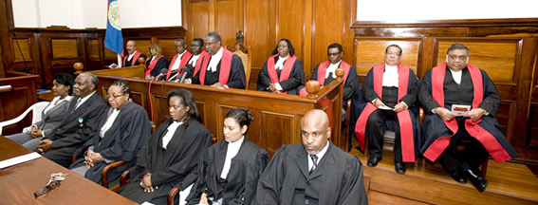
Judiciary
The justice system is broadly based on English Common Law, with the Supreme Court, the Court of Appeal, and magistrates’ courts. The Supreme Court hears serious civil and criminal cases before judges and jury. The Court of Appeal generally sits four times a year.
Preliminary hearings of less serious civil cases are in the district courts and those of criminal cases are in summary jurisdiction courts. Both district and summary jurisdiction courts are magistrates’ courts.
The judiciary, which is one of the three separate arms of the State, is headed by the Chief Justice, who has overall responsibility for the administration of justice in Belize.
The Supreme Court has unlimited original jurisdiction to hear and determine any civil or criminal proceedings under any law. In its criminal jurisdiction, a Judge sits with a jury made up of 12 members for capital offence cases and made up of 9 members for non-capital offence cases.
The Court of Appeal exercises appellate jurisdiction over both the High Court and Magistracy and has jurisdiction and powers to hear and determine appeals in civil and criminal matters. While this Court is established with a President and three Justices of Appeal, a panel of three Justices sits at any one time.
In June 2010 the Caribbean Court of Justice in Port of Spain, Trinidad and Tobago, became the final court of appeal, replacing the Privy Council in the UK.
Notes:
Feedback: Make chart
Minimise and be more concise

Slide 7
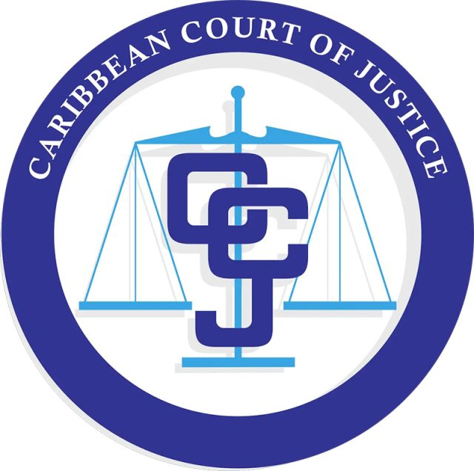
Judicial Process
The legal system is modelled on English common law. A chief justice heads the Supreme Court, but the Court of Appeal is the country’s highest court; both are independent of the national government.
In 2001 Belize joined most members of Caricom to establish a Caribbean Court of Justice (CCJ), which was inaugurated in 2005. Civil and criminal cases that were heard in the Court of Appeal were brought before the Judicial Committee of the Privy Council, while cases regarding Caricom treaties were appealed in the CCJ.
In 2009 Belize adopted the CCJ as its final court of appeal, replacing the Privy Council.

Slide 8
ADR
Alternative Dispute Resolution, also referred to as ADR, is a method of communicating and addressing conflict in a manner other than formal litigation and court proceedings.
As the name suggests, when two or more parties need to resolve a dispute, ADR utilizes alternative resolution techniques, such as negotiation, mediation and arbitration.
Legal counsel may be utilized, but ADR does not necessarily require representation by an attorney. ADR is less expensive, and less complicated than court action. It is private and confidential.
(https://www.belize.org/services/mediation-alternative-dispute-resolution/)
Belize's labor dispute resolution system employs a dual approach, utilizing both formal labor courts and arbitration processes. (https://www.rivermate.com/guides/belize/dispute-resolution)
Notes:
What, Agreements, Why ADR
Feedback: why is adr used/not used in Belize?

Slide 9
Legal Aid
The Legal Aid Bill of 2023 made legal aid readily available to persons of small or moderate economic means; to enable the cost of providing legal aid granted to persons of small and moderate economic means to be defrayed wholly or partly out of money provided for that purpose by the National Assembly; and to provide for matters connected therewith or incidental thereto. https://www.nationalassembly.gov.bz/wp-content/uploads/2023/05/Act-No-15-of-2023-Legal-Aid-Act.pdf
Eligibility and Services
Divorces
Probate and succession matters
Adoptions
Family matters at the Family Court and the High Court
Criminal matters in the Magistrate's Court
Civil matters in the High Court and the Magistrates Court
Traffic Matters
Agreements
Contracts
Powers of Attorneys
Land matters
Notes:
What, who is eligible, Cost, Process, when it is denied

Slide 10
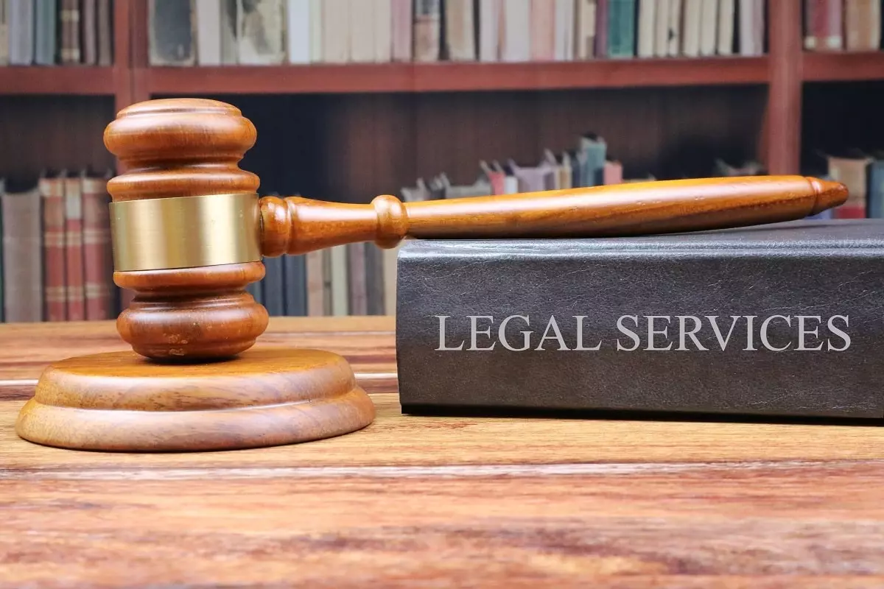
Legal Aid
The Legal Aid Bill of 2023 made legal aid readily available to persons of small or moderate economic means; to enable the cost of providing legal aid granted to persons of small and moderate economic means to be defrayed wholly or partly out of money provided for that purpose by the National Assembly; and to provide for matters connected therewith or incidental thereto. https://www.nationalassembly.gov.bz/wp-content/uploads/2023/05/Act-No-15-of-2023-Legal-Aid-Act.pdf
Eligibility and Services
Divorces
Probate and succession matters
Adoptions
Family matters at the Family Court and the High Court
Criminal matters in the Magistrate's Court
Civil matters in the High Court and the Magistrates Court
Traffic Matters
Agreements
Contracts
Powers of Attorneys
Land matters

Slide 11
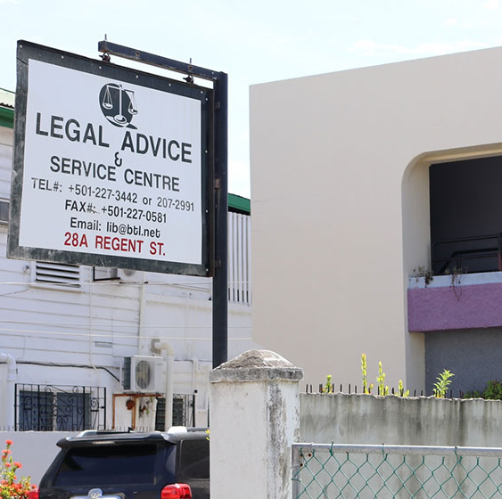
Legal Aid
The Centre screens clients and charges on a set scale but substantially below private practice costs and in some instances nothing at all.
There are currently two offices: a general office in Belize City and a district office in Orange Walk Town
There is currently a consultation fee of $50.00 to see an attorney. Such fee will only be waived in extreme cases.
Appointments can be done through the contact information provided below. However, Clients can be dealt with by simply walking into the office.

Slide 12
Legal News
Reyes v. R (2022 JCPC)
This case challenged the constitutionality of the mandatory death penalty in Belize and whether the lack of individualized sentencing of murder by shooting was compatible with the constitutional protection against inhumane treatment. The Privy Council quashed the sentence and remitted the case for resentencing after finding that the mandatory death penalty was incompatible with the constitutional protection of human rights and that the lack of individualized sentencing in cases of murder by shooting was inconsistent with the constitutional safeguards against cruel and inhuman punishment.
https://www.jcpc.uk/docs/21-09-10-case-for-the-appellant.pdf, https://www.casemine.com/judgement/uk/5b46f2392c94e0775e7f3d04
Notes:
Feedback: Recent case(s) re CARICOM and/or decided by the Privy Council or CCJ
Recent legislation involving the legal profession and/or the CARICOM

