Slide 1
BENEFITS OVERVIEW
January 1, 2024 - December 31, 2024
Notes:
Welcome to Stetson University and thank you for taking the time to review your benefit options. As a new employee, you are eligible for benefits the first of the month after your hire date. For example, if your hire date is October 10th, your benefits will begin on November 1st.

Slide 2
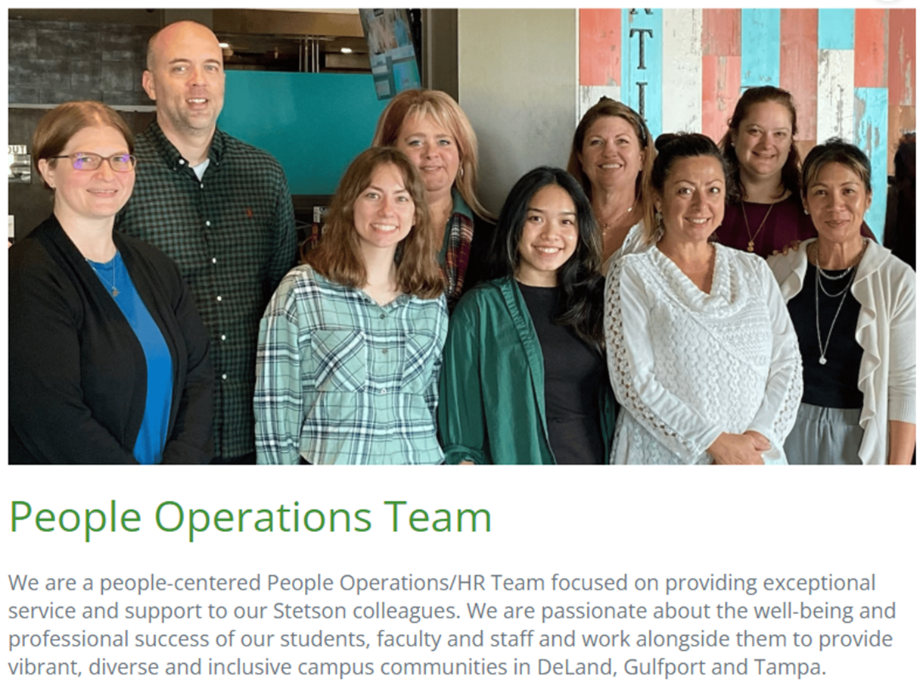
WELCOME TO STETSON UNIVERSITY
Employee Benefits Guide in MyStetson
Complete all Benefit elections in the Benefits Portal
Contact HR at 727.562.7945 or humres@stetson.edu
Notes:
There are many resources available to you regarding your benefits. The Employee Benefits Guide and Benefits Portal can be found in MyStetson. Please contact People Operations at 727.562.7945 or email us at humres@stetson.edu should you have any questions.

Slide 3
ENROLL IN THE FOLLOWING BENEFITS:
HEALTH
DENTAL
VISION
FLEXIBLE SPENDING ACCOUNT
DEPENDENT CARE SPENDING ACCOUNT
LIFE INSURANCE
AFLAC
METLIFE
Notes:
You will be able to enroll in benefits through the Benefits Portal which can be found in MyStetson. Stetson offers the following benefits: Health Insurance, Dental Insurance, Vision coverage, Flexible and Dependent Care Spending Accounts, Life Insurance, AFLAC and MetLife

Slide 4
BENEFIT ELIGIBILITY
EMPLOYEES
FACULTY & STAFF
FULL-TIME BENEFIT ELIGIBLE
EMPLOYEE’S DEPENDENT(S)
SPOUSE OR DOMESTIC PARTNER (AFFIDAVIT REQUIRED)
DEPENDENT CHILDREN
CHILDREN, STEPCHILDREN, CHILDREN OF YOUR DOMESTIC PARTNER, OR CHILDREN IN YOUR GUARDIANSHIP UP TO AGE 26
DEPENDENT ELIGIBILITY VERIFICATION – PLEASE SUBMIT DOCUMENTATION TO HR TO VERIFY DEPENDENT(S)
Notes:
Who is eligible? All full-time faculty and staff are eligible including dependents such as your spouse or domestic partner and dependent children. Dependent children are defied as your children, stepchildren, children of your domestic partner, or children in your guardianship up to age 26. Documentation will be required to verify dependents.

Slide 5
IMPORTANT DATES AND DEADLINES
1ST OF THE FOLLOWING MONTH
Your insurance benefits will be effective on 1st of the month following your hire date. Ex. If your hire date is April 22, 2024, your benefits become effective May 1, 2024.
30 CALENDAR DAYS
Benefit Eligible employees have 30 calendar days from their hire date to enroll in benefits online.
A qualifying event (also known as a change in status) is a major life event which makes you eligible to enroll, change, or waive health and life insurance benefits outside of the open enrollment period. Benefit changes must be made within 30 calendar days of the qualifying event. Ex. Qualifying event examples include marriage, birth or adoption of a child, death of a covered dependent, divorce or legal separation, and loss or gain of health insurance coverage.
Notes:
A few important dates to remember – Benefits begin the 1st of the month following your hire date and you have 30 days from the date of hire to enroll in benefits online. Once enrolled, you can not make changes unless you have a qualifying event such as marriage, birth or adoption of a child, death of covered dependent, divorce or legal separation, and loss or gain of health insurance coverage elsewhere. If you experience a qualifying event, you have 30 days to inform People Operations of the change.

Slide 6
YOU MUST ENROLL DURING NEW HIRE ELIGIBILITY PERIOD IF YOU WANT COVERAGE IN CERTAIN BENEFITS SUCH AS…
Health Plan
Dental Plan
Vision Plan
Flexible Spending Account – Health and Dependent Care
Legal Plan
Supplemental Plan
Notes:
You must enroll during new hire eligibility if you want coverage otherwise you will have to wait until open enrollment or qualifying event. Let’s review the plans in more detail. Information on rates can be found in the Benefits Guide and Benefits Portal.

Slide 7
FLORIDABLUE HEALTH PLANS
FloridaBlue Care HMO
Copay based plan
Open Access – no referrals needed, but you must select a Primary Care Physician
FloridaBlue – Blue Options PPO
Deductible & Coinsurance based plan
Lower deductible than PPO
Florida based network, narrower than PPO plan
Lower cost per paycheck
Larger and national network
Includes Mayo clinic
Includes out of network coverage
RxBenefits - Prescription
Pharmacy Benefit optimizer
Notes:
There are 2 health plans offered through FloridaBlue. One is the HMO plan and the other is the PPO plan. The HMO plan is a copay based plan with a lower deductible. However, the network is a Florida based network. The PPO plan is a deductible/coinsurance based plan and has a larger national network that also includes out of network coverage. Pharmacy benefits is through RxBenefits.

Slide 8
DELTA DENTAL PLANS
DHMO
PPO STANDARD
PPO ENHANCE
Notes:
Dental coverage is offered through Delta Dental. There are 3 plan options. The DHMO plan and PPO Standard and PPO Enhance plans. The DHMO plan is a copay driven plan with a limited network and the PPO plans are coinsurance coverage plans with an annual maximum and larger network.

Slide 9
VSP VISION CARE PLAN
Eye Exam Copay
Copay for lenses
Allowance towards frames or contacts lenses
Notes:
Vision coverage is through VSP or Vision Service Plan. The plan provides a copay for eye exams and lenses and an allowance towards frames or contact lenses.

Slide 10
Flexible & Dependent Care Spending Accounts
The FSA is administered by HealthEquity.
An FSA allows you to set aside pre-tax dollars to pay for eligible medical and dependent care expenses. Your contribution is deducted from your paycheck and deposited into your FSA Account pre-tax.
The Health Care FSA annual maximum contribution is $3,200.
The Dependent Care FSA annual maximum contribution is $5,000.
$640 of the remaining FSA funds in your 2024 Health Care FSA will carryover into the 2025 plan year. Balances above $640 will be forfeited.
Notes:
Stetson offers Flexible Spending Account or FSA. The FSA is administered by Health Equity and is a way for you to set aside pre-tax dollars to use towards eligible medical and dependent care expenses. You choose the contribution you would like to deduct from you paycheck and the funds are deposited into you FSA account and you will receive a debit card. Please know that with the Flexible Spending Account, balances over $640 will be forfeited at the end of the year.

Slide 11
Life Insurance, AD&D, Short-Term and Long-Term Disability
Full-time employees are provided with employer paid basic life insurance and AD&D benefits. Benefits = 1x annual salary rounded up to the nearest $1,000 at a maximum benefit amount of $250,000
Voluntary Life Insurance
$200,000 Guaranteed Issue for new hires (or up to 5x’s annual salary)
Minimum amount = $10,000
Maximum amount = $350,000 (Evidence of Insurability is required for coverage amounts in excess of $200,000)
Spousal coverage up to 100% of employee elected amount (max of $100,000).
Child coverage is available at additional cost ($10,000 policy)
100% employee paid
Short-term disability and long-term disability benefits are employer paid and provide income protection during leaves of absence due to illness or injury
Notes:
Life insurance, short term and long term disability are employer paid benefits. You are provided with basic life insurance and ad&d benefits equivalent to 1 times your annual salary. You have the option to purchase additional life insurance for yourself and dependents.

Slide 12
Retirement
Teachers Insurance and Annuity Association (TIAA) administers the university defined contribution 403(b) plan.
A 457(b) plan is available for qualified employees.
After one year of service, Stetson University will contribute 5% of monthly gross earnings to your retirement account. After two years of service, Stetson University will contribute 10% of monthly gross earnings.
Administrative and full-time faculty will receive employer contributions the first of the month following date of hire. (must have proof of prior participation)
Employee contributions can be made immediately. Please create a TIAA member account at https://www.tiaa.org/public/tcm/stetson or call 1-800-842-2252 to get started.
Notes:
We are committed to helping employees reach their retirement goals. The retirement plan is a 403b plan through TIAA. After 1 year of employment, the university will contribute 5% of your gross base salary and after 2 years of employment, the university will contribute 10% of your gross base salary. You are eligible to participate and contribute either pre-tax or after-tax beginning the 1st of the month following your date of hire.

Slide 13
Employee Assistance Program (EAP)
The EAP is offered through New Directions, for support at no cost to you or anyone in your household 24 hours a day, 365 days a year.
100% confidential
Services include
Counseling – up to 4 counseling sessions per issue
Legal and Financial Resources
Work/Life Services
Life Coaching
BetterHelp online therapy platform
To learn more visit eap.ndbh.com and enter code stetson, or call 800-624-5544
Notes:
Our EAP or employee assistance program is through New Directions. This is a free and confidential resource that is available to you and anyone in your household. The EAP includes services such as up to 4 counseling sessions per issue, legal and financial resources, work/life balance, life coaching, and many other resources. Please feel free to contact them 24 hours a day, 365 days a year.

Slide 14
Tuition Benefits
Full-time employees, their spouse, and dependent children are eligible for the tuition waiver benefit upon completion of the 90-day probationary period
Enrollment application must be made with the Office of Admissions
Tuition waivers must be completed 30 days prior to the start of each semester
Tuition Exchange
Stetson University participates in the CIC (Council of Independent Colleges) and TEP (Tuition Exchange Program). Tuition exchange is a reciprocal scholarship opportunity for the dependents of eligible faculty and staff at consortium member schools. Each member institution has specific guidelines for imports and exports. Please visit the Tuition Exchange page for detailed information on the program.
Notes:
Stetson University offers tuition waiver for employees, their spouse and dependent children upon completion of the 90-day probationary period. In addition, Stetson participate in the Tuition Exchange which is a reciprocal scholarship opportunity for dependents. Please visit the tuition exchange page in the Benefits page in MyStetson.

Slide 15
Additional Benefits
Aflac
Accident
Hospital Indemnity
Critical Illness
Cancer
MetLaw
MetLaw gives you access to experienced, pre-qualified attorneys for an unlimited number of personal legal matters
Wishbone Pet Insurance
90% reimbursement on accidents and illnesses
A low $250 annual deductible
Quick claims processing in 5 business days
Lost pet recovery service and 24/7 pet telehealth
Optional wellness riders
Notes:
Other benefits offered include AFLAC which is supplemental insurance. The plans offered are the Accident, Hospital Indemnity, Critical Illness and Cancer plans. In addition, we offer legal resources through MetLaw and Pet Insurance through Wishbone.

Slide 16
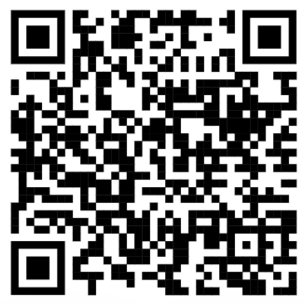
Thank you!
Please scan for Stetson University’s Benefits webpage
13
Notes:
Thank you again for reviewing the benefits information. The QR code will take you to the benefits webpage where you can find additional information regarding benefits. Hope you have a great day!

