Slide 1
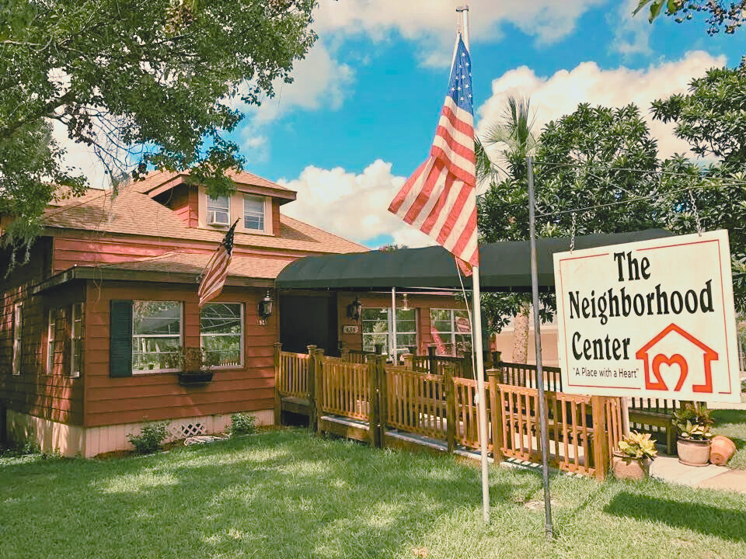

t
HOW TO BUILD A
FUNDRAISING CAMPAIGN
Stetson University Non-Profit Leadership Summit
February 7, 2025
www.neighborhoodcenterwv.org

Slide 2
Eight Steps for a
Successful Fundraising Campaign
1
Define Your Campaign and Goals
  2
  Identify Your Target Audience
  3
  Develop Your Fundraising Strategy
  4
  Craft Your Messaging & Storytelling
  5
  Set a Campaign Timeline and Milestones
  6
  Establish Your Budget and Resources
  7
  Plan for Donor Stewardship and Follow-Up
  8
  Evaluate and Reflect on Success

Slide 3
1. Define Your Campaign Purpose & Goals
  Identify the purpose of your campaign
  Define your fundraising goal (financial target)
  Highlight the impact these funds have on your organization or community

Slide 4

2. Identify Your Target Audience
  Identify potential donors (individuals, businesses, foundations, etc.)
  What motivates them to give?
  How will you reach them?
Come Together Reel

Slide 5




Come Together
55 Years
of
Impact
Celebrating
EST 1969

Slide 6
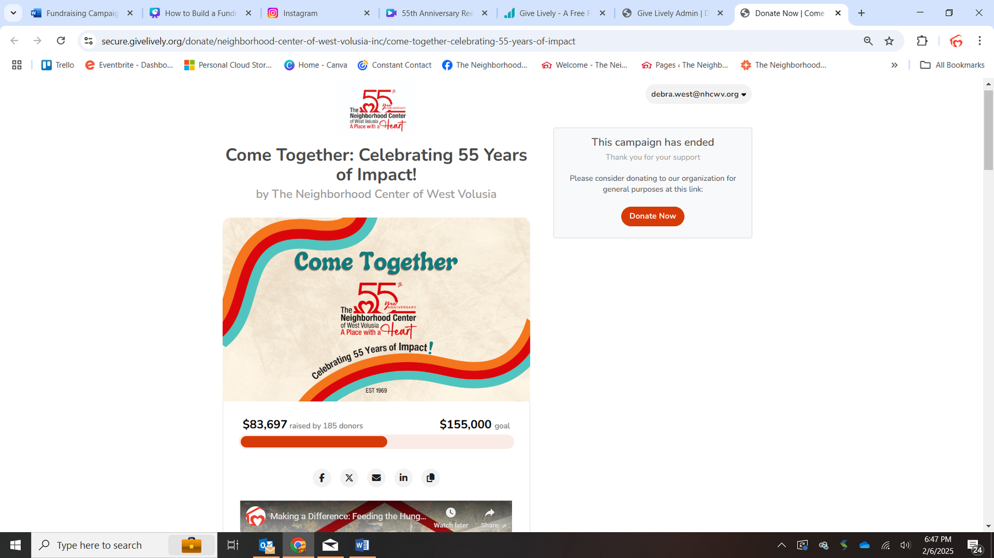
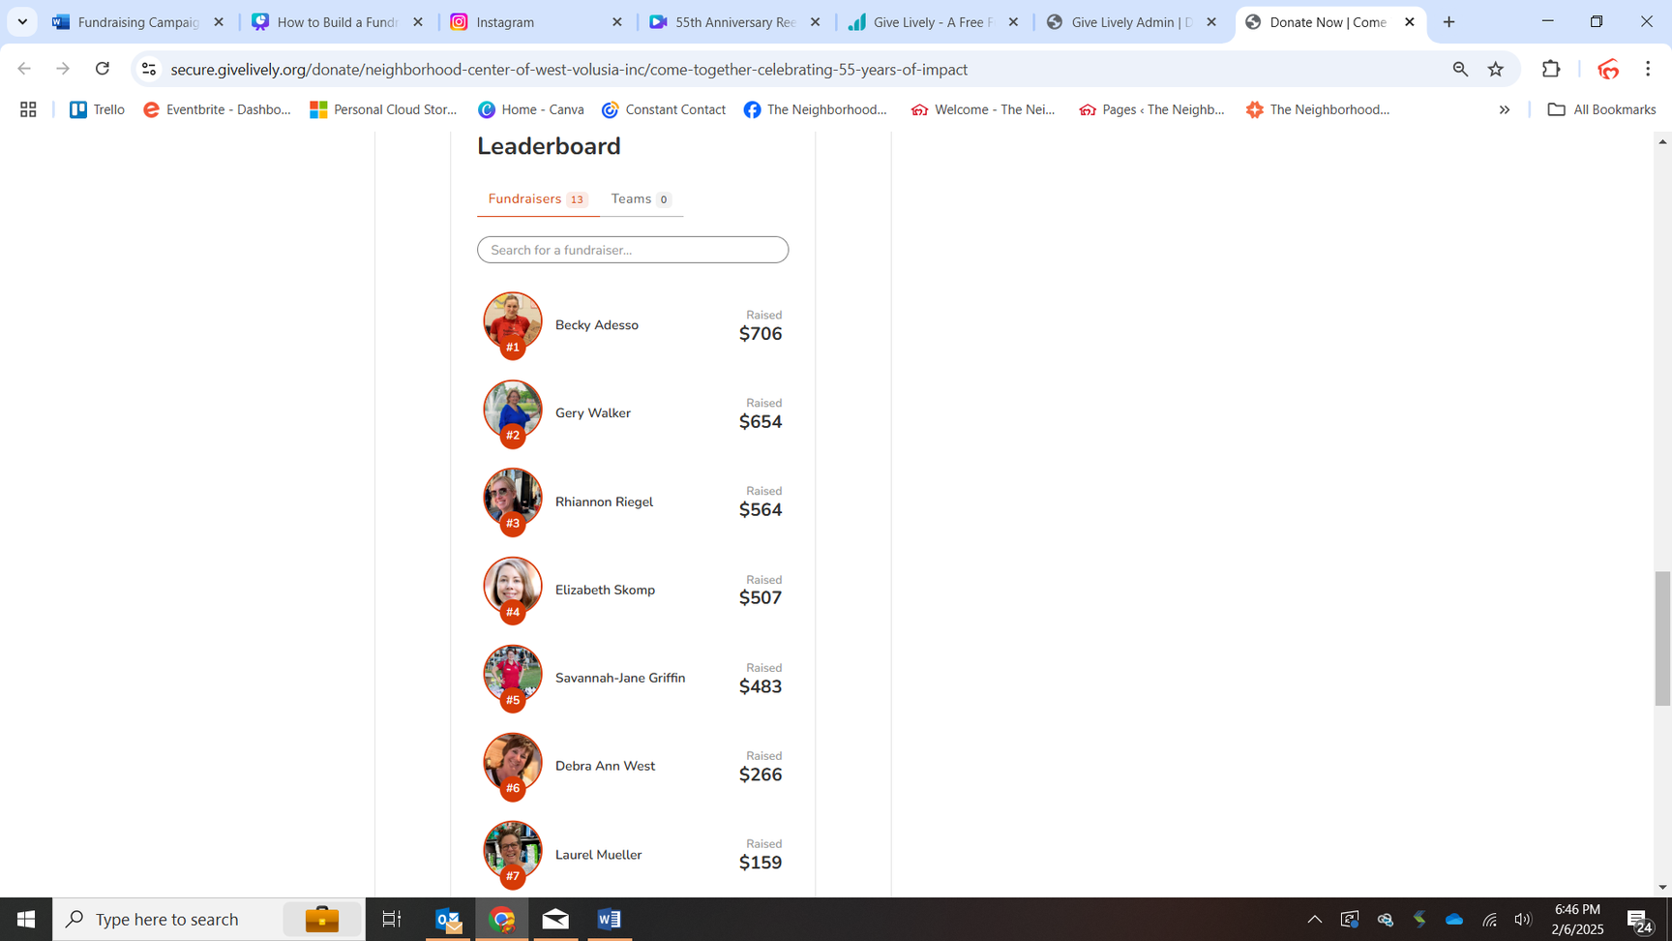

3. DEVELOP YOUR FUNDRAISING STRATEGY
  Identify fundraising methods (e.g., online giving, peer-to-peer fundraising, events, grants)
  Offer donor incentives or recognition
  Secure partnerships that could help amplify your campaign
  Identify and assign tasks (who will do what?)

Slide 7

4. CRAFT YOUR MESSAGING AND STORYTELLING
  Name your campaign
  Identify compelling story
  Emphasize urgency and impact

Slide 8


Come
Together
Your donation today ensures families a safe place to live.
55 Years
of
Impact
Celebrating
EST 1969

Slide 9
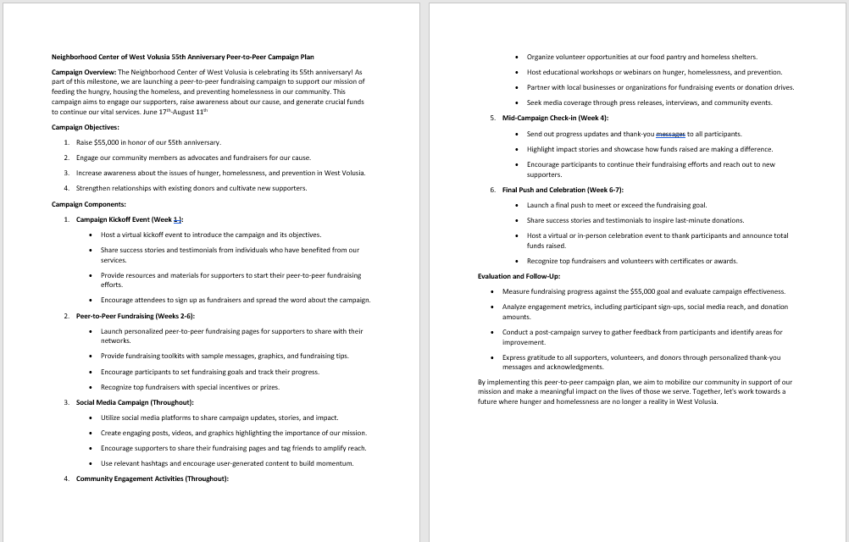

5. SET A CAMPAIGN TIMELINE & MILESTONES
  Identify start and end date
  Identify key milestones will you track (e.g., 25% funded, halfway mark, last push)?
  Communications timeline to supporters on progress
NHCWV 55th Anniversary Campaign Plan

Slide 10
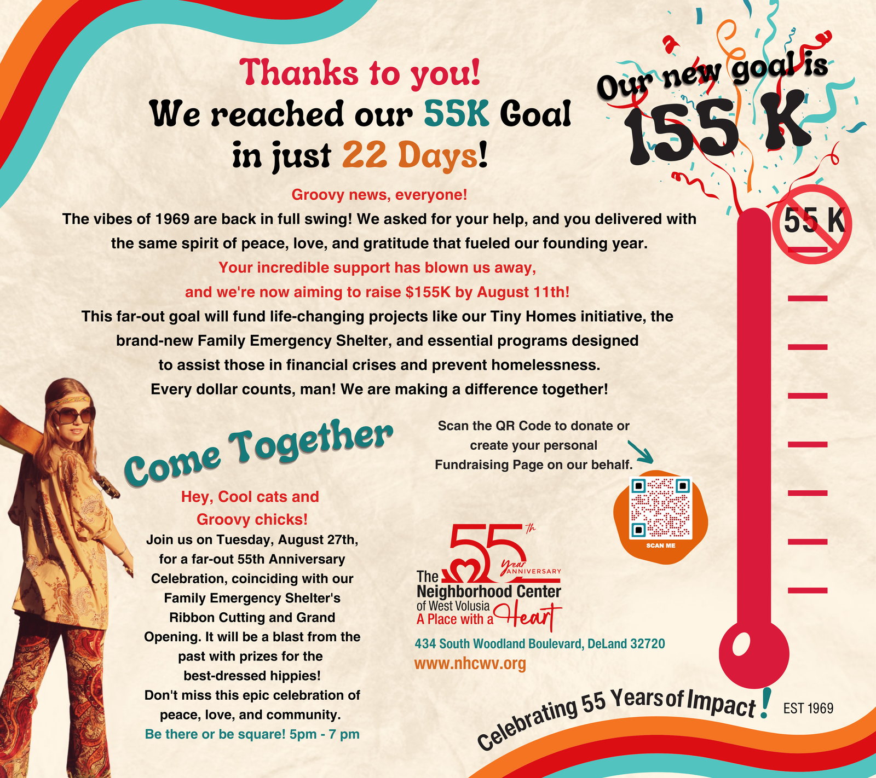
Be
prepared
to pivot.

Slide 11
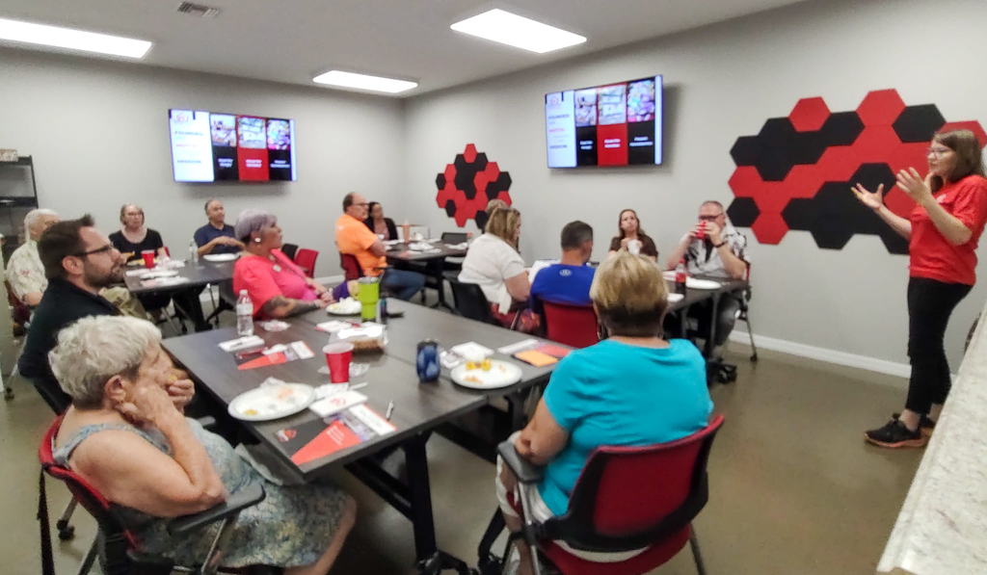

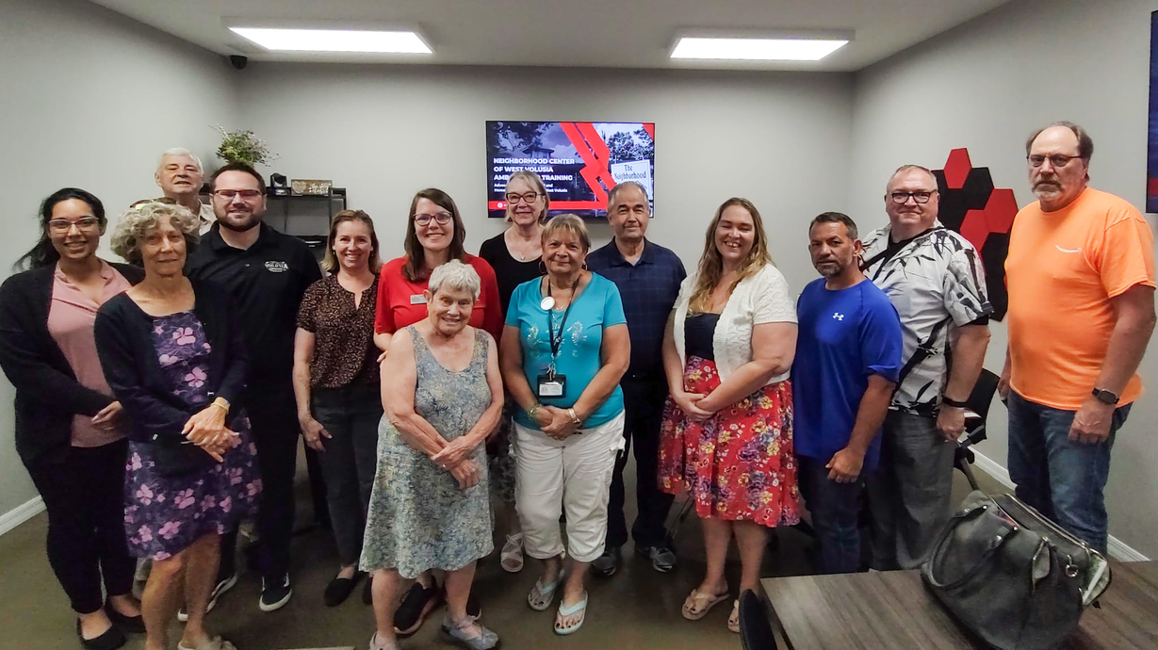
6. ESTABLISH YOUR BUDGET AND RESOURCES
  Estimate costs of running the campaign (marketing, staff time, materials, event expenses, etc.)
  Identify resources you have and what you will need
  Use volunteers and ambassadors to spread the word
NHCWV Ambassador Training

Slide 12
7. PLAN FOR DONOR
STEWARDSHIP & FOLLOW-UP
  Thanking and recognizing donors
  Post-Campaign Communication
  Plan to keep donors engaged for future giving opportunities
  What impact did the donor's contribution have on your mission/success

Slide 13
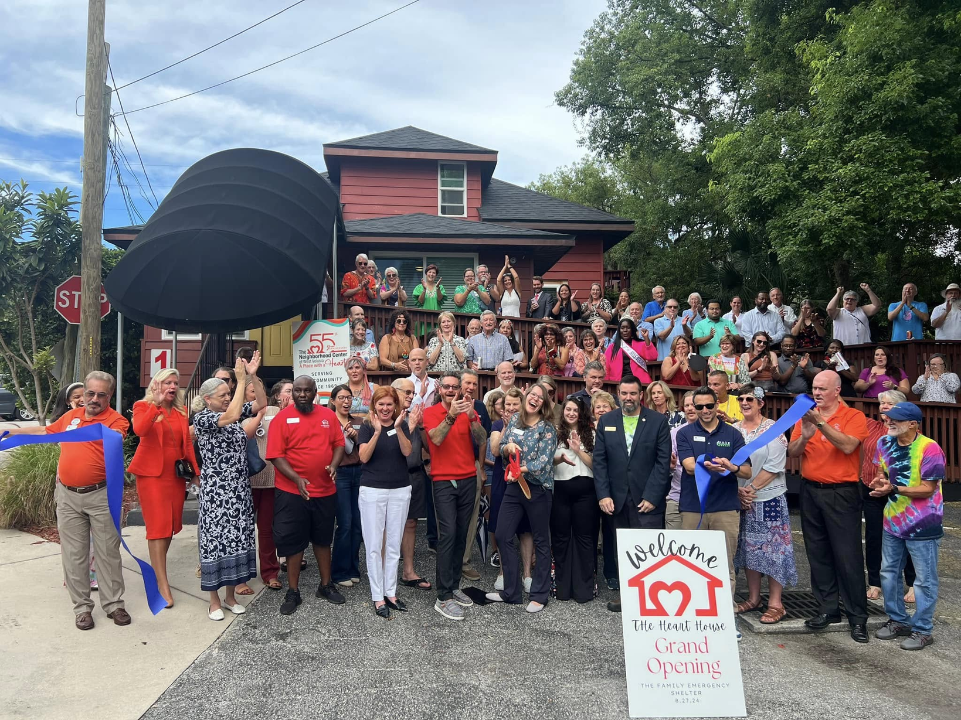
8. EVALUATE AND REFLECT ON SUCCESS
  Metrics to measure success
  Lessons learned
  Celebrate!

